Slide 1
Rotation, moment of inertia and Torque

Slide 2
Intended Learning Outcomes
To describe angular displacement, velocity and acceleration
To apply rotational kinematic equations
To calculate the moments of inertia of a rigid body
To solve rotational problems via energy considerations
To analyze the rolling motion of a rigid body

Slide 3
Rigid Object
A rigid object is one that is non-deformable.
  The relative locations of all particles making up the object remain constant.
  All real objects are deformable to some extent, but the rigid object model is very useful in many situations where the deformation is negligible.

Slide 4
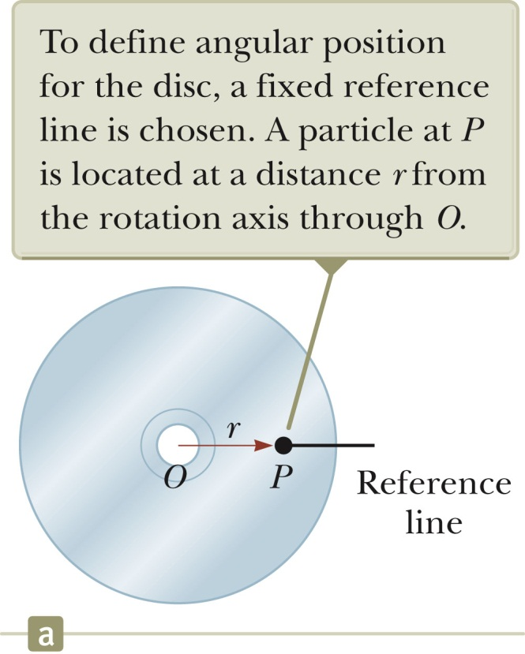
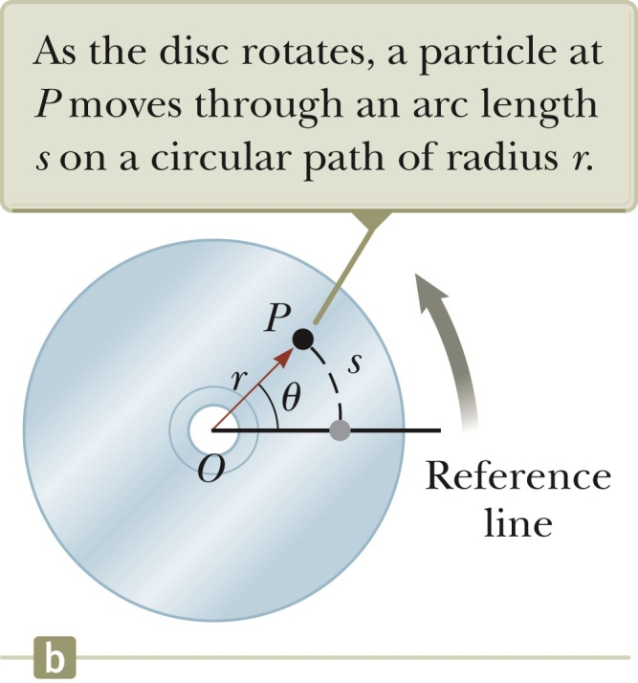
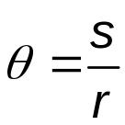
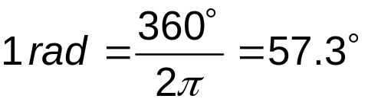
Angular Position
Axis of rotation is the center of the disc
Choose a fixed reference line.
Point P is at a fixed distance r from the origin.
In (b), P is located at (r, θ) in polar coordinates.
The arc length and r are related:
  s = θ r, or
has the unit radian.

Slide 5
Angular Position, final
We can associate the angle θ with the entire rigid object as well as with an individual particle.
  Remember every particle on the object rotates through the same angle.
The angular position of the rigid object is the angle θ between the reference line on the object and the fixed reference line in space.
  The fixed reference line in space is often the x-axis.
The angle θ plays the same role in rotational motion that the position x does in translational motion.

Slide 6
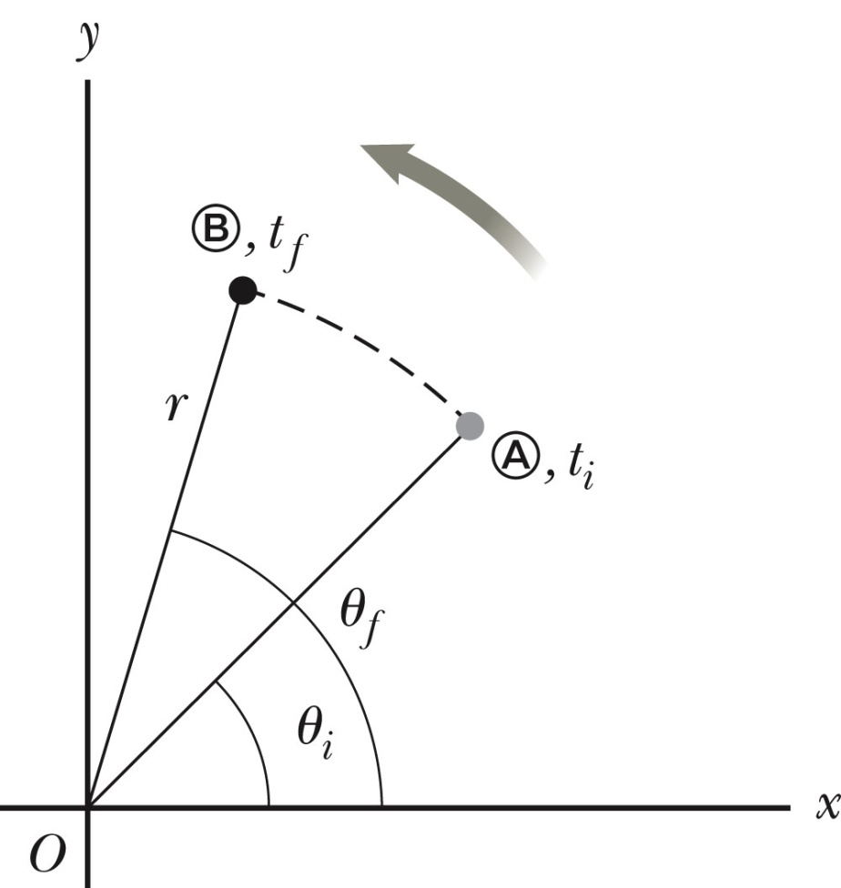
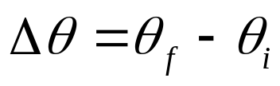
Angular Displacement
The angular displacement is defined as the angle the object rotates through during some time interval.
This is the angle that the reference line of length r sweeps out.
Convention: counterclockwise as positive.

Slide 7
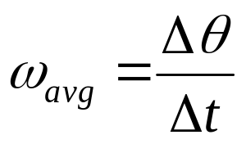
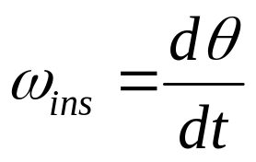
Angular Speed
The average angular speed, ω_{avg}, of a rotating rigid object is the ratio of the angular displacement to the time interval.
The instantaneous angular speed is defined as the limit of the average speed as the time interval approaches zero.
This is analogous to translational speed. Units of angular speed are radians/sec.
  rad/s or s⁻¹ since radians have no dimensions.
Angular speed will be positive if θ is increasing (counterclockwise)
Angular speed will be negative if θ is decreasing (clockwise)

Slide 8
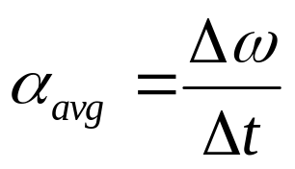
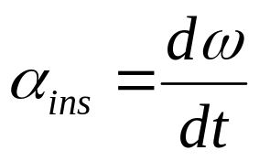
Angular Acceleration
The average angular acceleration, α _{avg}, of an object is defined as the ratio of the change in the angular speed to the time it takes for the object to undergo the change.
The instantaneous angular acceleration is defined as the limit of the average angular acceleration as the time goes to 0.
Units of angular acceleration are rad/s² or s⁻² since radians have no dimensions.
Angular acceleration will be positive if an object rotating counterclockwise is speeding up, or if an object rotating clockwise is slowing down.

Slide 9
Angular Motion, General Notes
When a rigid object rotates about a fixed axis in a given time interval, every portion on the object rotates through the same angle in a given time interval and has the same angular speed and the same angular acceleration.
  So θ, ω, α all characterize the motion of the entire rigid object as well as the individual particles in the object.

Slide 10
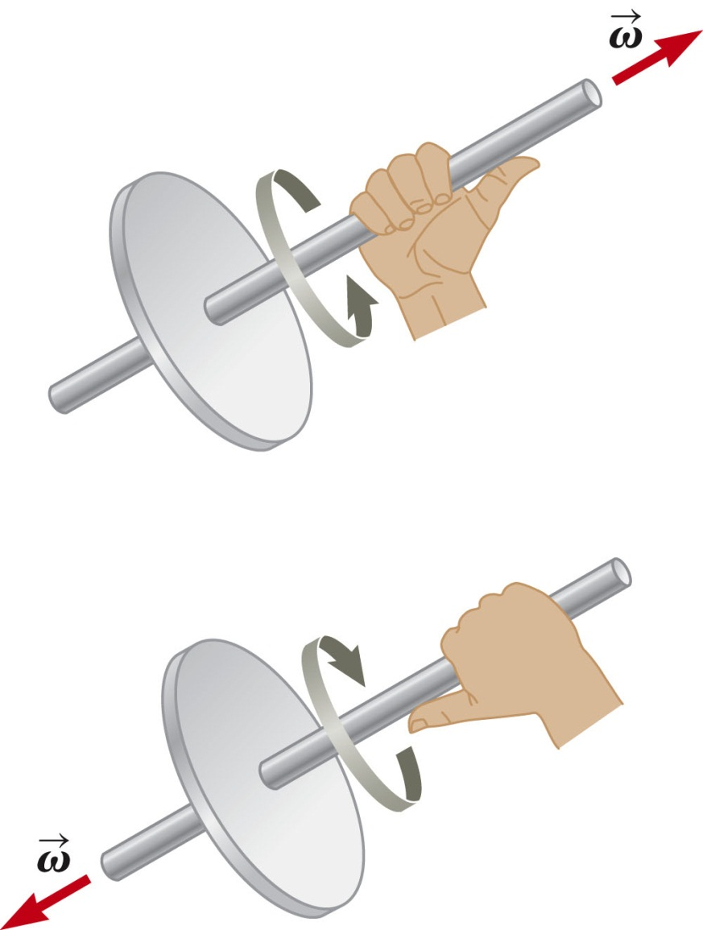
Directions, details
Strictly speaking, the angular speed and angular acceleration (ω, α) are the magnitudes of the angular velocity and angular acceleration vectors.
The directions are actually given by the right-hand rule.

Slide 11
Hints for Problem-Solving
Similar to the techniques used in linear motion problems.
  With constant angular acceleration, the techniques are much like those with constant linear acceleration.
There are some differences to keep in mind.
  For rotational motion, define a rotational axis.
    The choice is arbitrary.
    Once you make the choice, it must be maintained.
    In some problems, the physical situation may suggest a natural axis, such as the center of an automobile wheel.
  The object keeps returning to its original orientation, so you can find the number of revolutions made by the body.

Slide 12
Rotational Kinematics
Under constant angular acceleration, we can describe the motion of the rigid object using a set of kinematic equations.
  These are similar to the kinematic equations for linear motion.
  The rotational equations have the same mathematical form as the linear equations.
The new model is a rigid object under constant angular acceleration.
  Analogous to the particle under constant acceleration model.

Slide 13
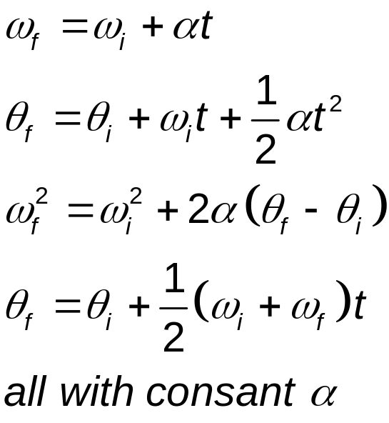
Rotational Kinematic Equations
The kinematic expression for the rigid object under constant angular acceleration are of the same mathematical form as those for a particle under constant acceleration.
Substitutions from translational to rotational are
  x → θ
  v → ω
  a → α

Slide 14
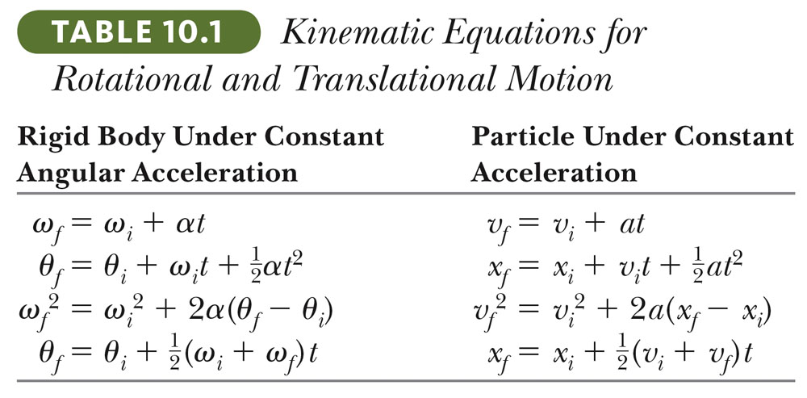
Comparison Between Rotational and Linear Equations

Slide 15
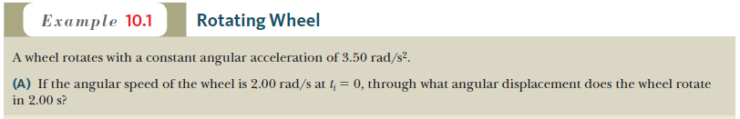





Slide 16
Relationship Between Angular and Linear Quantities
Every point on the rotating object has the same angular motion.
Every point on the rotating object does not have the same linear motion.
Displacements
  s = θ r
Speeds
  v = ω r
Accelerations
  a = α r
r₁
r₂

Slide 17
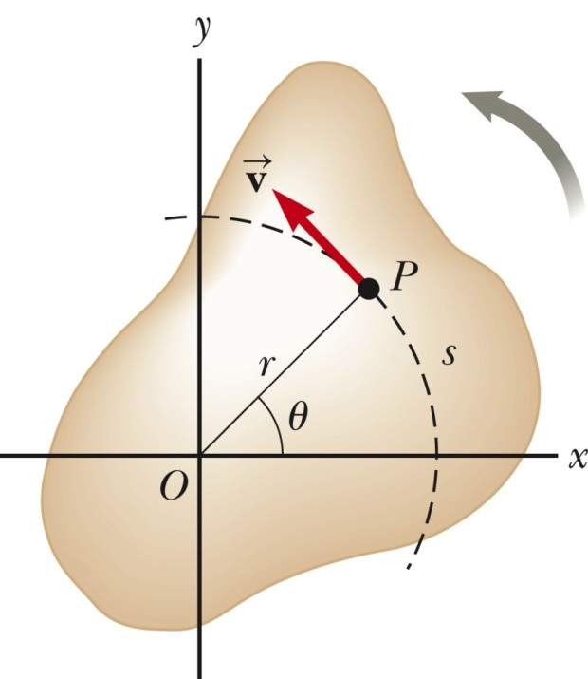
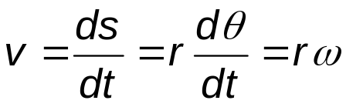
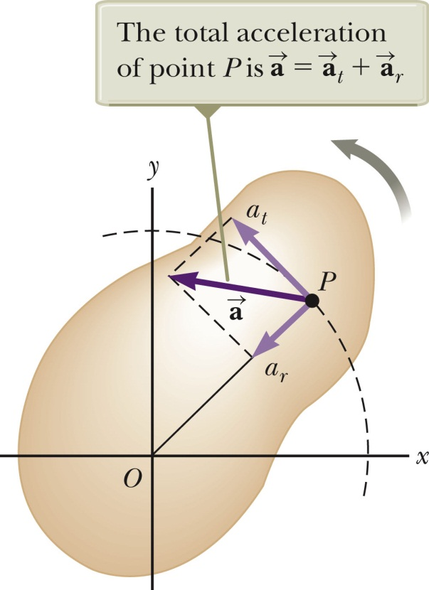
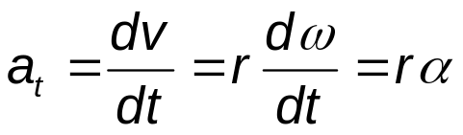
Speed Comparison – Details
The linear velocity is always tangent to the circular path,
  Called the tangential velocity
The magnitude is defined by the tangential speed.
Since r is not the same for all points on the object, the tangential speed of every point is not the same.
The tangential acceleration is the derivative of the tangential velocity.
Do not mix up with the centripetal acceleration, a_{r} .

Slide 18
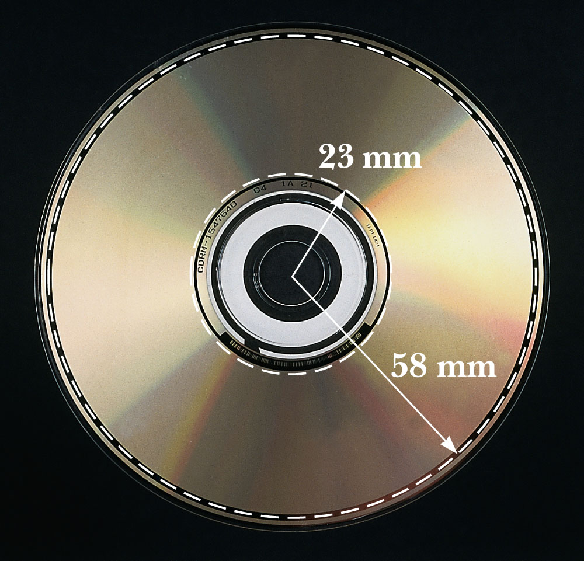
Rotational Motion Example
For a compact disc player to read a CD, the angular speed must vary to keep the tangential speed constant (v_{t} = ωr).
  Typically the constant speed of the surface at the point of the laser-lens system is 1.3 m/s.
At the inner sections, the angular speed is faster than at the outer sections.

Slide 19


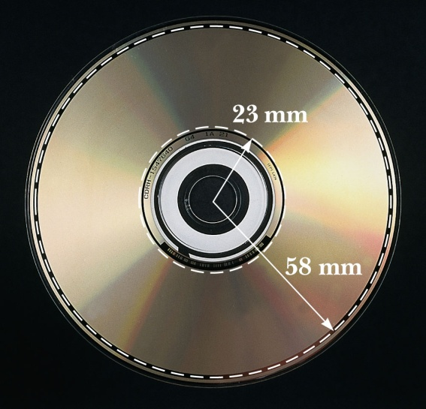
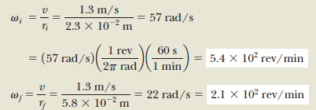



Slide 20
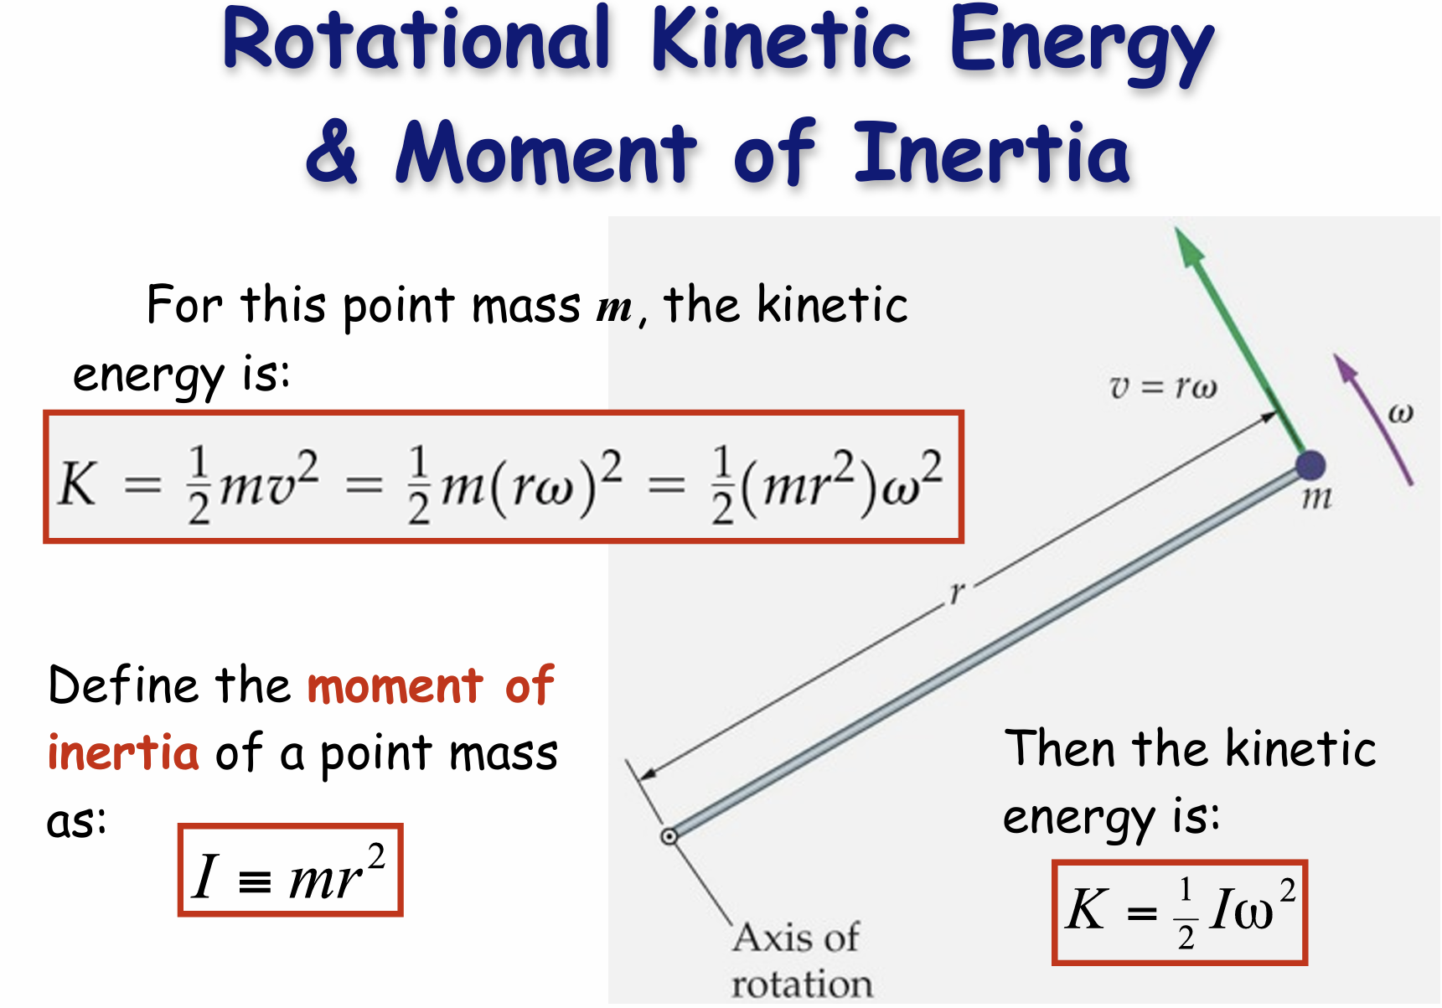

Slide 21
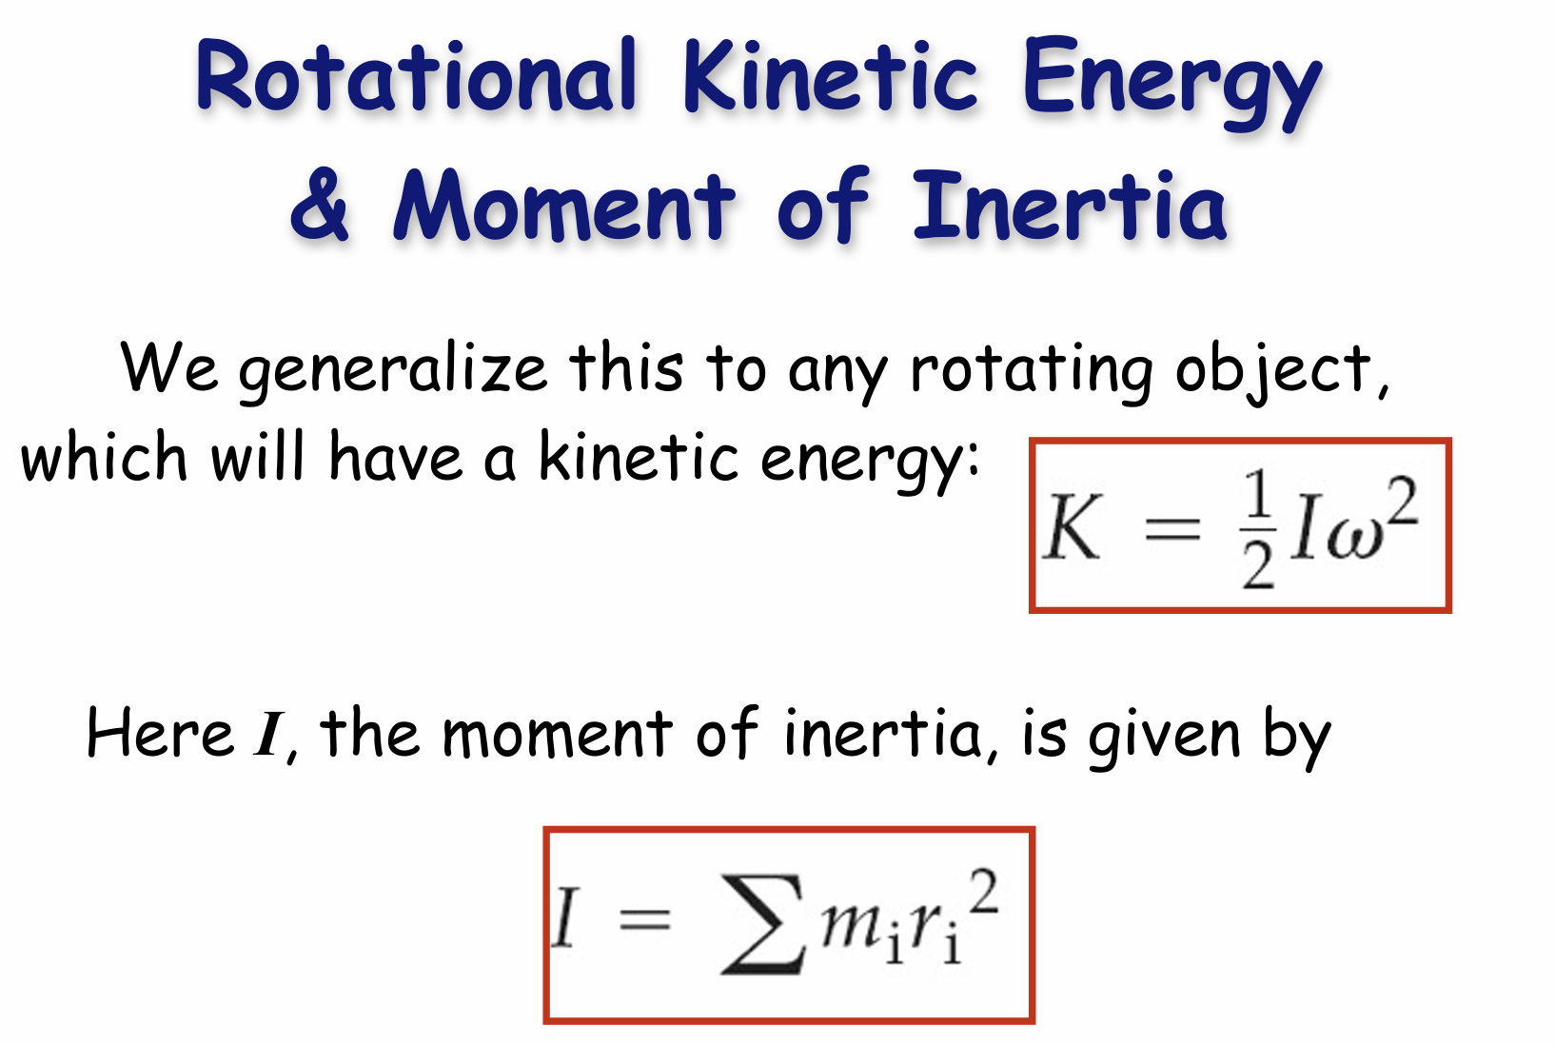

Slide 22
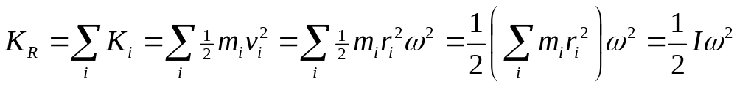
Rotational Kinetic Energy
An object rotating about some axis with an angular speed, ω, has rotational kinetic energy even though its center of mass may not have any translational kinetic energy. To calculate for the associated rotational kinetic energy, we divide the object as many small particles.
Each particle has a kinetic energy of
  K_{i} = ½ m_{i}v_{i}²
Since the tangential velocity depends on the distance, r, from the axis of rotation, we can substitute v_{i} = r_{i}ω .
The total rotational kinetic energy of the rigid object is the sum of the energies of all its particles.
I is called the moment of inertia.

Slide 23
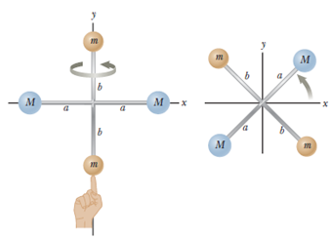




Section 10.4

Slide 24
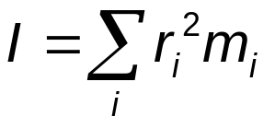
Moment of Inertia
The definition of moment of inertia is
The dimensions of moment of inertia are ML² and its SI units are kg.m^{2.}
We can calculate the moment of inertia of an object more easily by assuming it is divided into many small volume elements, each of mass Δm_{i.}
Mass is an inherent property of an object, but the moment of inertia depends on the choice of rotational axis.
Moment of inertia is a measure of the resistance of an object to changes in its rotational motion, similar to mass being a measure of an object’s resistance to changes in its translational motion.
  The moment of inertia depends on the mass and how the mass is distributed around the rotational axis.

Slide 25
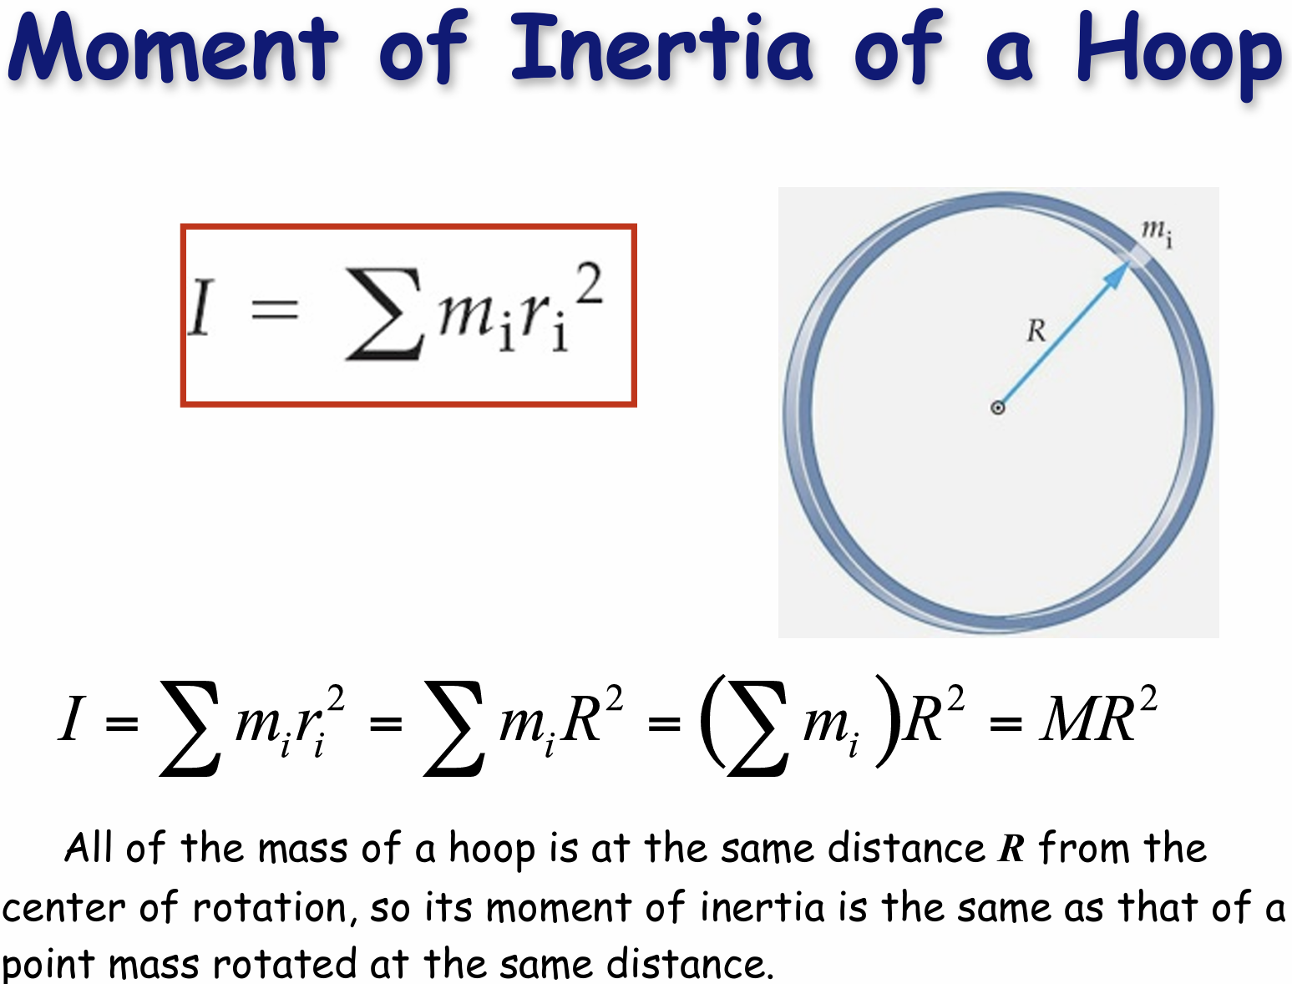

Slide 26
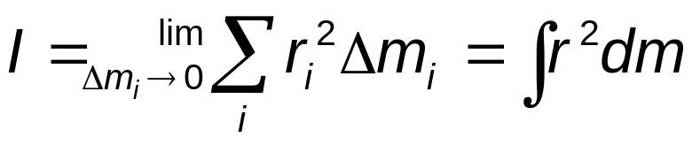

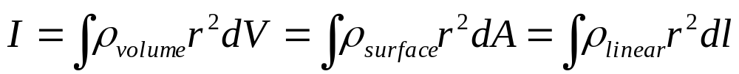
Moment of Inertia, cont
The moment of inertia of a system of discrete particles can be calculated by applying the definition for I.
For a continuous rigid object (such as a rod or a sphere), imagine the object to be divided into many small elements, each having a mass of Δm_{i.}
We can rewrite the expression for I in terms of Δm.
With the small volume segment assumption ( )
If ρ is constant, the integral can be evaluated with known geometry, otherwise its variation with position must be known.

Slide 27


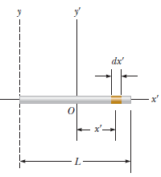

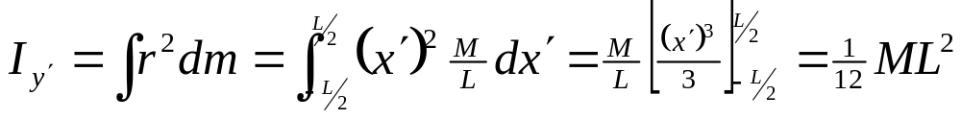
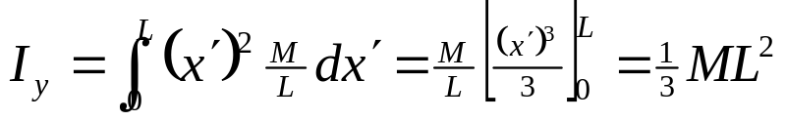

Slide 28
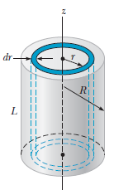
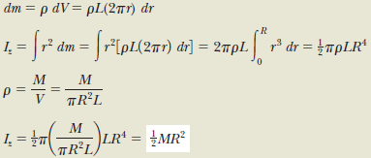

Slide 29
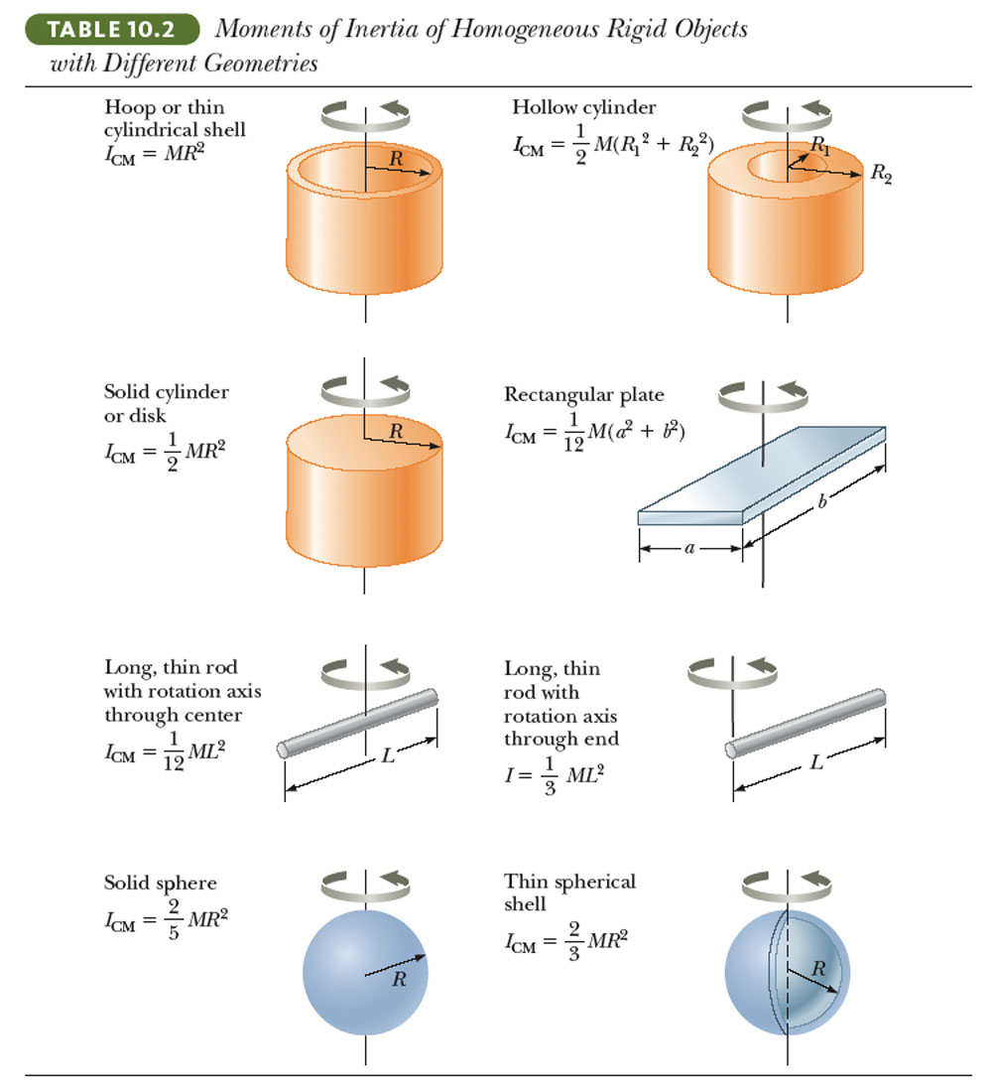
Moments of Inertia of Various Rigid Objects

Slide 30
Parallel-Axis Theorem
In the previous examples, the axis of rotation coincided with the axis of symmetry of the object.
For an arbitrary axis, the parallel-axis theorem often simplifies calculations.
The theorem states I = I_{CM} + MD ²
  I is about any axis parallel to the axis through the center of mass of the object.
  I_{CM} is about the axis through the center of mass.
  D is the distance from the center of mass axis to the arbitrary axis.

Slide 31
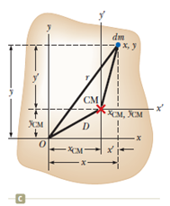

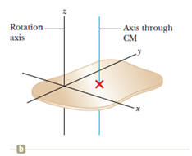


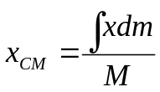
Parallel-Axis Theorem (Derivation)
I_{CM}

Slide 32
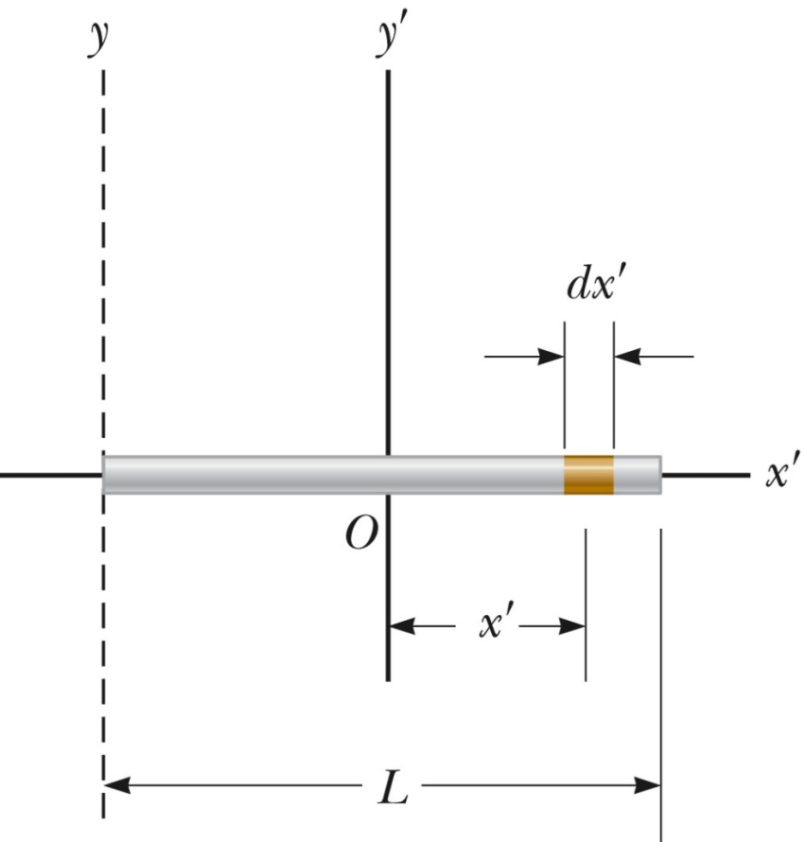

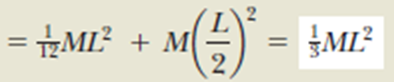

Slide 33
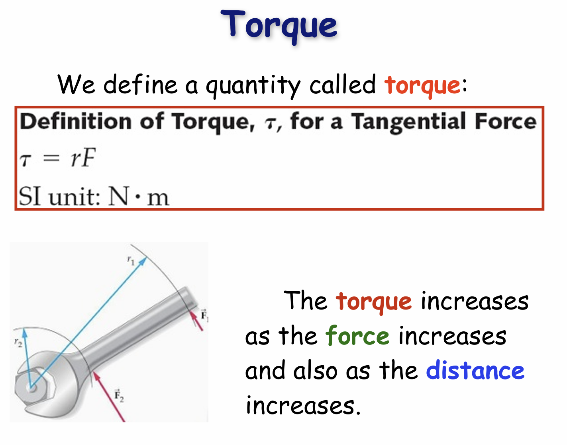


Slide 34
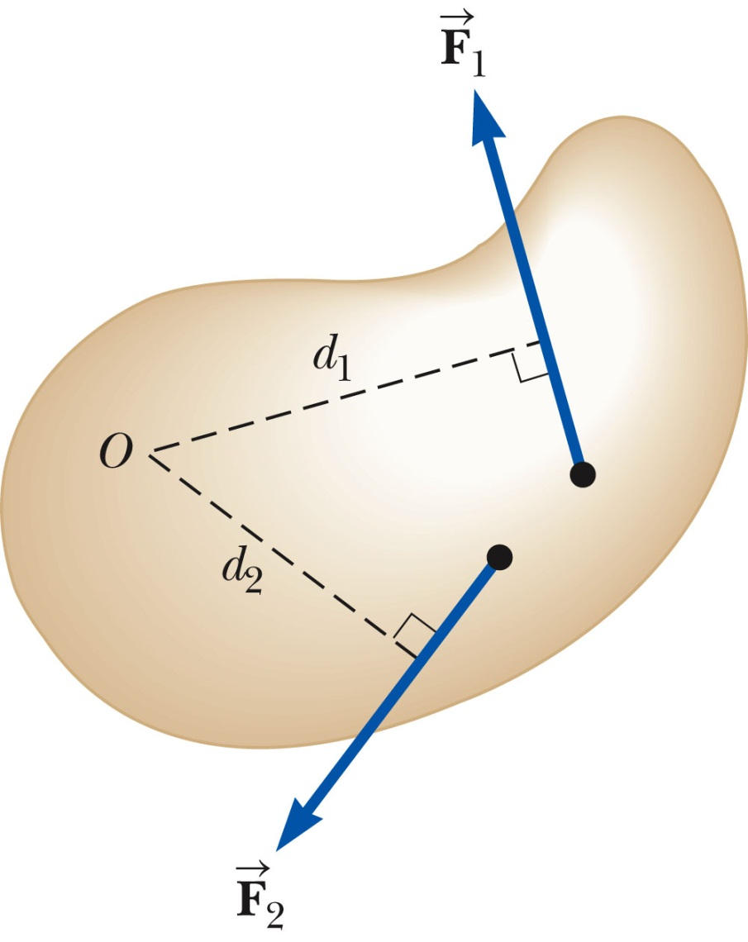


Net Torque
The force will tend to cause a counterclockwise rotation about O.
The force will tend to cause a clockwise rotation about O.
Στ = τ₁ + τ₂ = F₁d₁ – F₂d₂

Slide 35
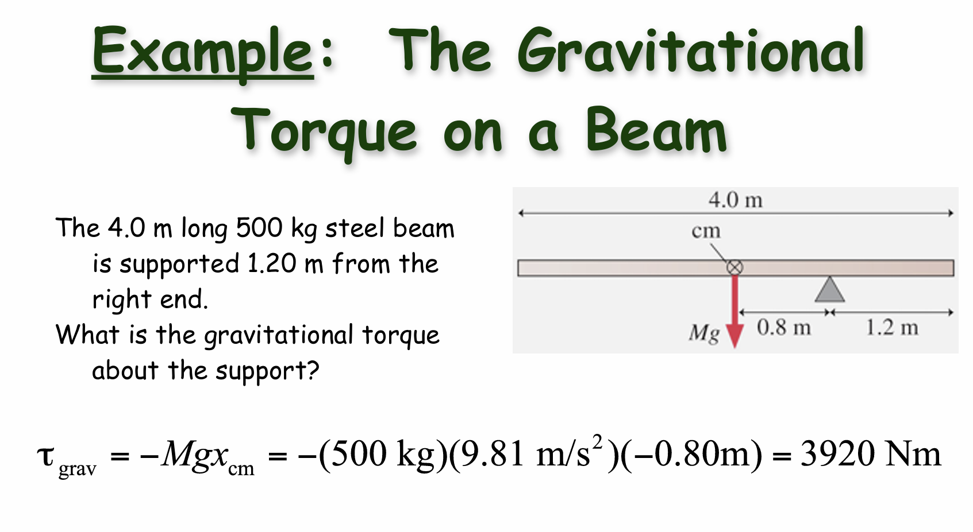

Slide 36
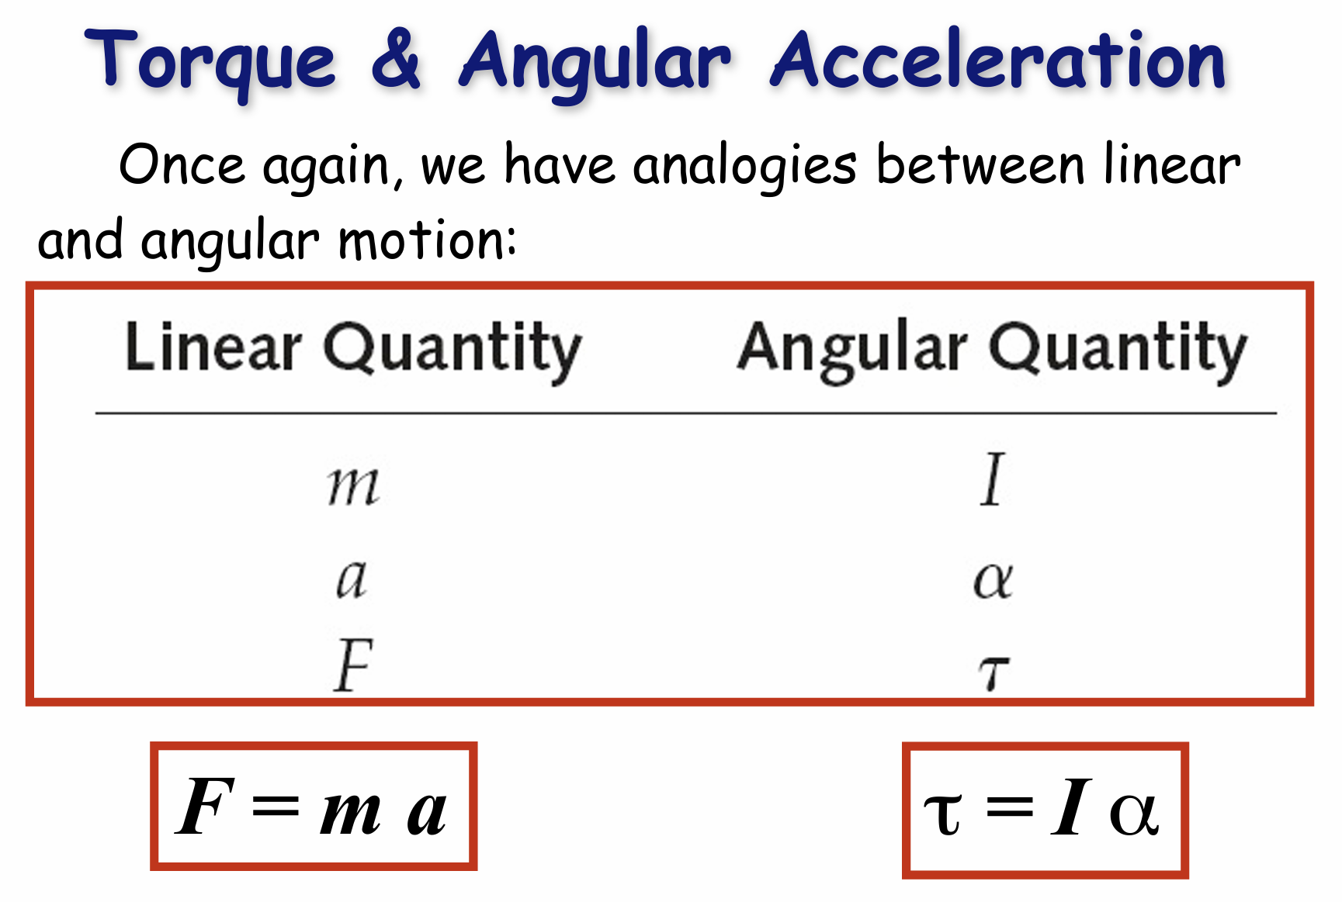

Slide 37
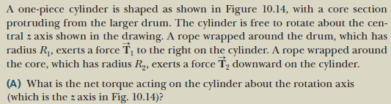
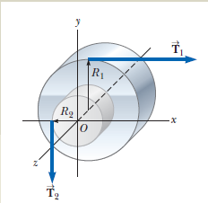

Slide 38
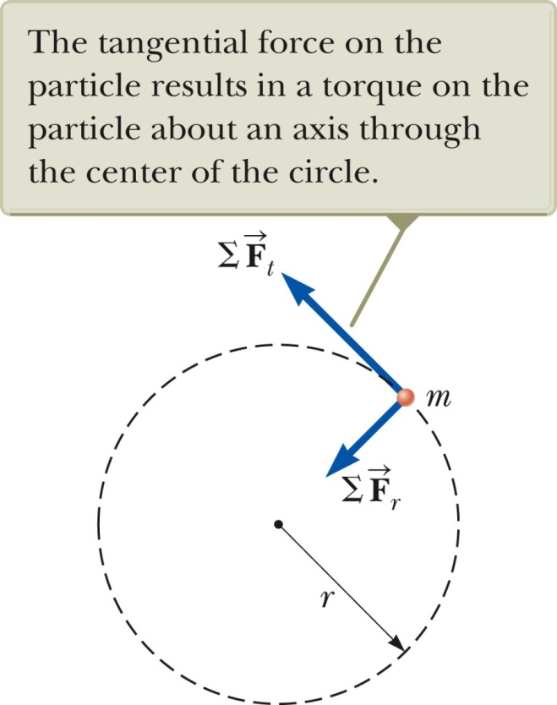


Newton’s second law in rotational form
Consider a particle of mass m rotating in a circle of radius r under the influence of tangential force .
The tangential force provides a tangential acceleration:
  F_{t} = ma_{t}
The radial force causes the particle to move in a circular path.
The magnitude of the torque produced by on a particle about an axis through the center of the circle is

Slide 39
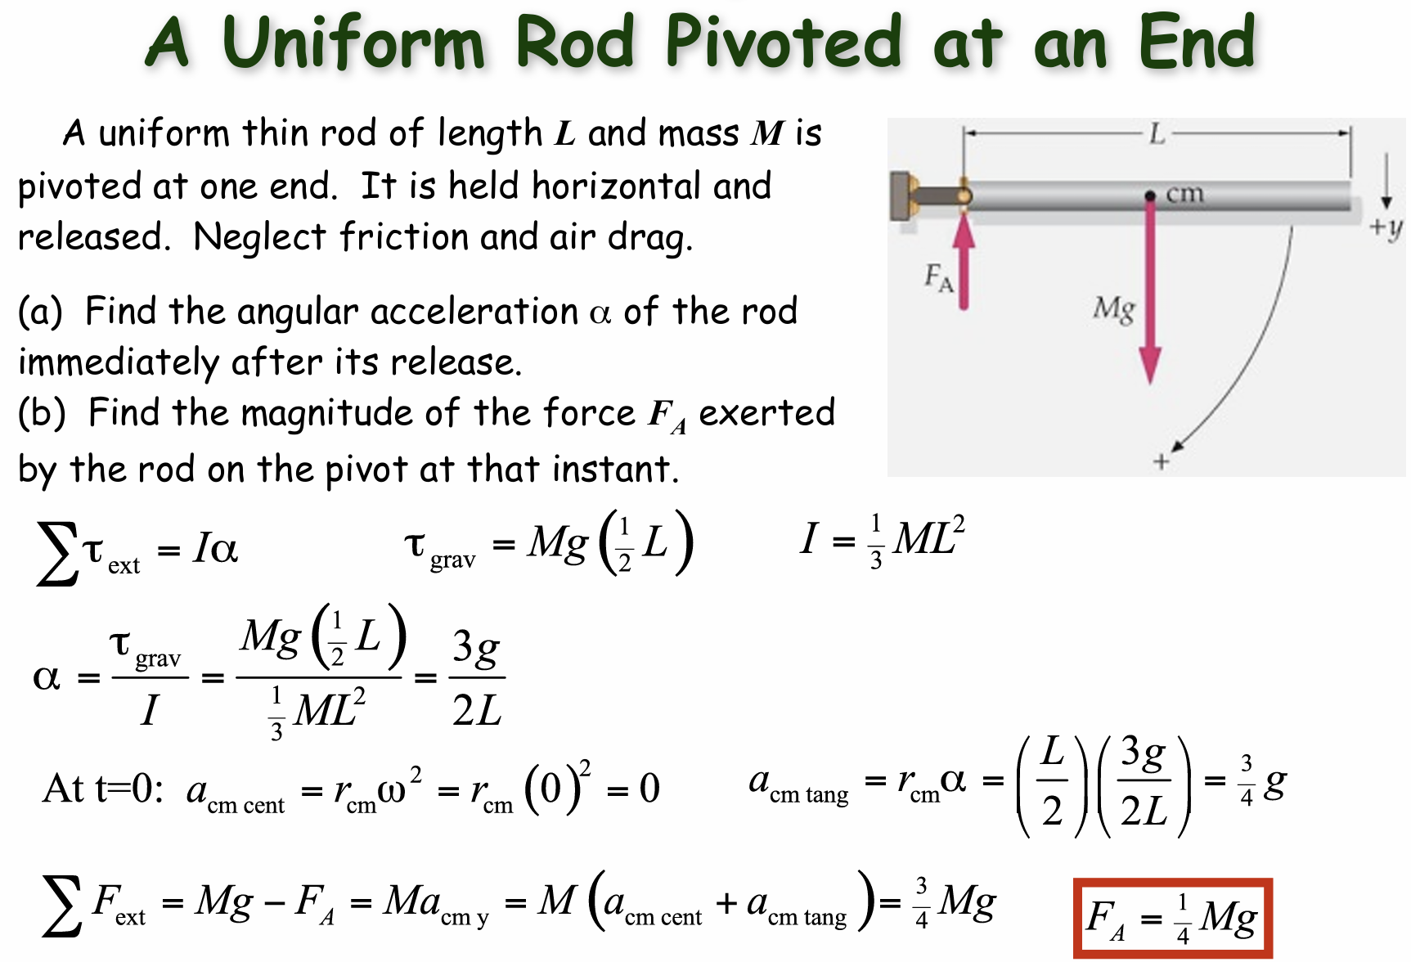

Slide 40

Each higher portion of the smokestack has a larger tangential acceleration than the points below it. The acceleration can even be greater than g (like the case in Example 10.8).
Such acceleration is due to the shear force from lower portion in addition to the gravitational force.
When the shear force is greater than the smokestack can withstand. The smokestack breaks.

Slide 41
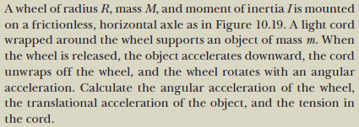
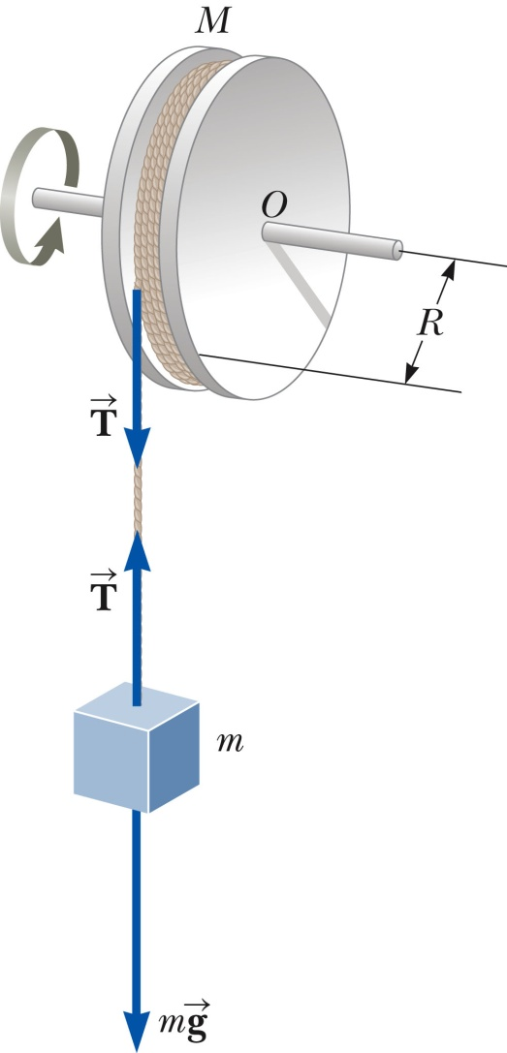



Slide 42


Slide 43





Work-kinetic energy theorem for rotational motion
Consider the work done by a force on the object as it rotates through an infinitesimal distance ds = r dθ.
The radial component of the force does no work because it is perpendicular to the displacement.
(Rotational kinetic energy)

Slide 44

Summary of Useful Equations

